Slide 1
Automated re-order of grocery using IOT
SURYA V ( 2021179051)
MCA (SS)
Project Guide:
Dr. T. J. Vijaykumar
Teaching Fellow
IST Dept, Anna University

Slide 2
Introduction
Grocery management can be cumbersome to most people as they have to manually keep track of each and every type of grocery on their own.
When going shopping, one could forget to get an item that would later be necessary.
Depleting or overstocking of grocery items is a common issue almost everyone faces.
We aim to solve these issues by reducing human intervention on stock management.
By making use of load cells, a grocery’s quantity can be identified and necessary restocking can be made by passing the order to a grocery delivery service.

Slide 3
Problem Statement
The problem of inefficient grocery inventory management can result in frequent store visits, wasted time and money, and often leads to shortages or excess purchases. To address this, the implementation of an automated re-order system that utilizes IoT for more efficient and cost-effective grocery inventory management.

Slide 4
Literature Survey
Ref | Name of the paper | Authors | Pros | Cons
1 | Home Groceries Management System Using IoT. Journal Paper 2020. | T. Manikandan, D. Tamil Selvan, R. Vaidhyanathan, B. Vigneshvaran and V. Nandalal | Quantity of groceries are displayed using a webpage. | It give only a alert message.
2 | IoT Based Smart Kitchen. Conference Paper · April 2019 . | Sravya Mandadi , Yashaswini C, Suraksha M, Mrs. Seema R. Karanth | The system is said to have a threshold limit set by the user, based on which alerts will be sent. | No use of machine learning predictions has been proposed in this research.
3 | IoT Based Smart Inventory Management System for Kitchen Using Weight Sensors, LDR, LED, Arduino Mega and NodeMCU (ESP8266) Wi-Fi Module with Website and App Conference Paper · April 2018 . | Sifat Rezwan, Wasit Ahmed, Mahrin Alam Mahia and Mohammad Rezaul Islam | Inventory checking is done inside a refrigerator with load cells. | Flexibility is affected, reconfiguration should be made when a compartment is used for storing other grocery items than what it was designed for. Its expensive to build in the initial stages

Slide 5
Literature Survey
Ref | Name of the paper | Authors | Pros | Cons
4 | Smart grocery management system using internet of things. Journal paper 2016. | Chetal. S. Patil, Kanaksing. N. Pawar | Ultrasonic sensors are proposed to be used in this research paper. This could be a better alternative to load cells | The downside being configuration. As the ultrasonic sensor data can’t be processed in a simple way, calibration needs to be made to read each and every type of grocery’s quantity which could limit the flexibility of the system.
5 | Grocery Re-identification using Load Balance Feature on the Shelf for Monitoring Grocery Inventory. | Rena Kamoda, Mayumi Ueda, Takuya Funatomi, Masaaki Iiyama and Michihiko Minoh | Transaction records are made to get better view of items, as inside the fridge the item could get hidden from camera’s view. The load cell combined with camera to verify the predicted quantity of the grocery item. | It could be very hard to design and a simple change in the shape a grocery item lets say a change in shape of a milk container, could throw off the whole system, as the system wasn’t trained on the new container’s shape.

Slide 6
Limitations of the existing works
Automated ordering to restock depleted items wasn’t considered in most papers
Less accurate methods of predictions.
Some papers proposed the idea of using hardware that are expensive, making the design difficult to implement.

Slide 7
Objectives of the proposed work
Solving the issue of understocking.
Letting users know when they’re going to run out on food.
Making an order for the required items on the user’s behalf.

Slide 8
Working principle
A Load Cell is used measure the weight of a container that holds a type of grocery.
The sensor data is then sent to the Arduino board’s microcontroller and gets processed.
Predictions are made to know when the grocery item will get depleted.
A server is then used to determine whether to make an order based on the processed data.
Delivery estimates are taken into account before making an order.
The order is then passed onto a grocery delivery service by an API call on behalf of the user.

Slide 9
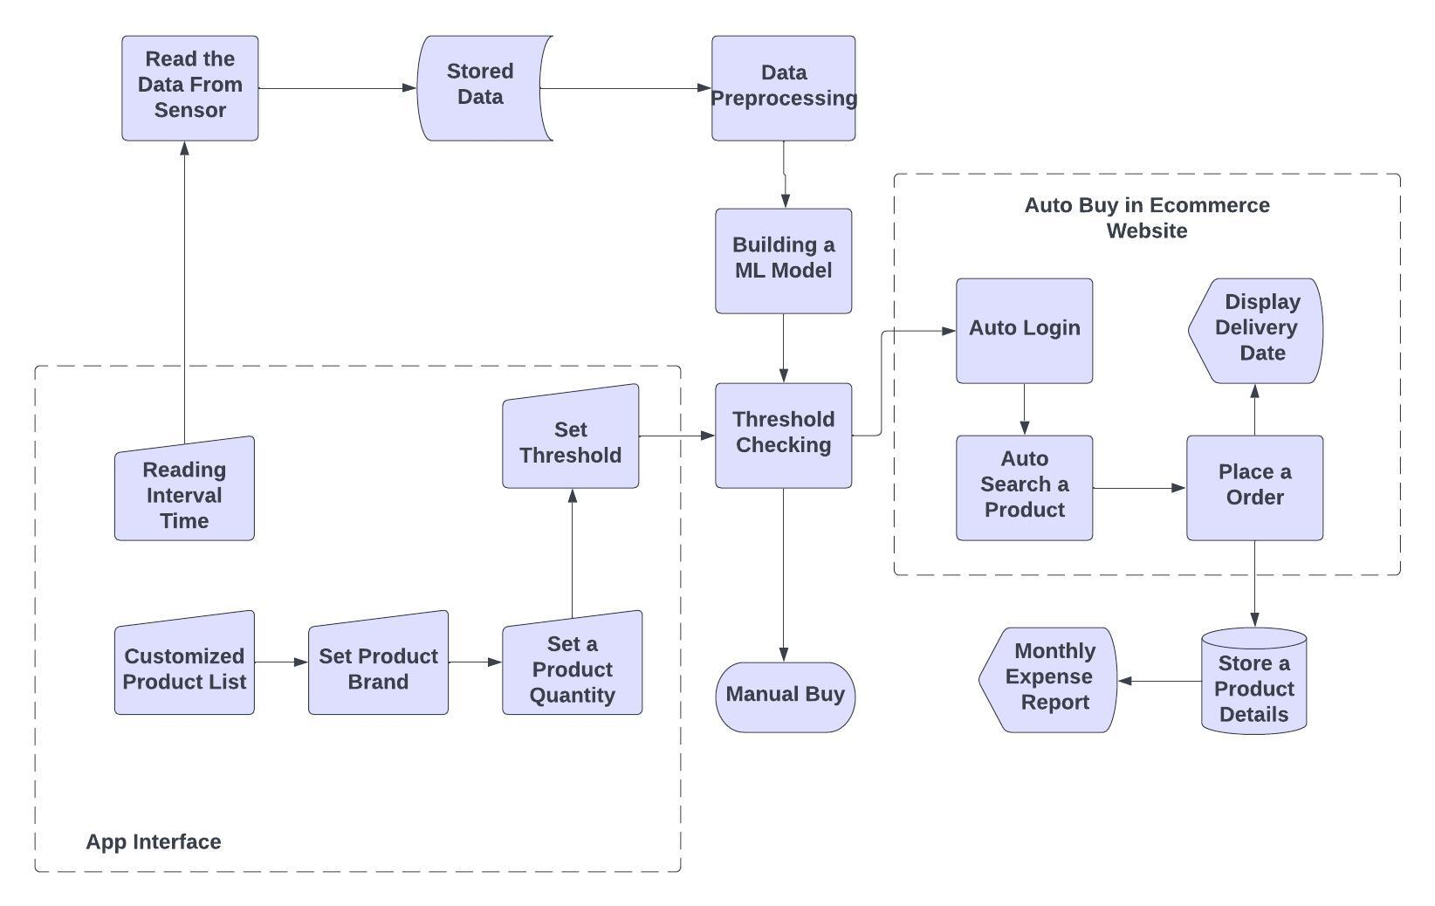
Architecture Diagram for Automated re-order of grocery using IOT

Slide 10
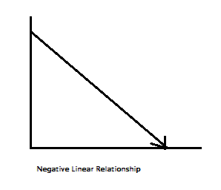
Order Prediction
Linear regression model is used to make predictions on when to make an order
The predictions are made based on weight and date as X and Y data
The average delay in delivery is taken as an offset

Slide 11
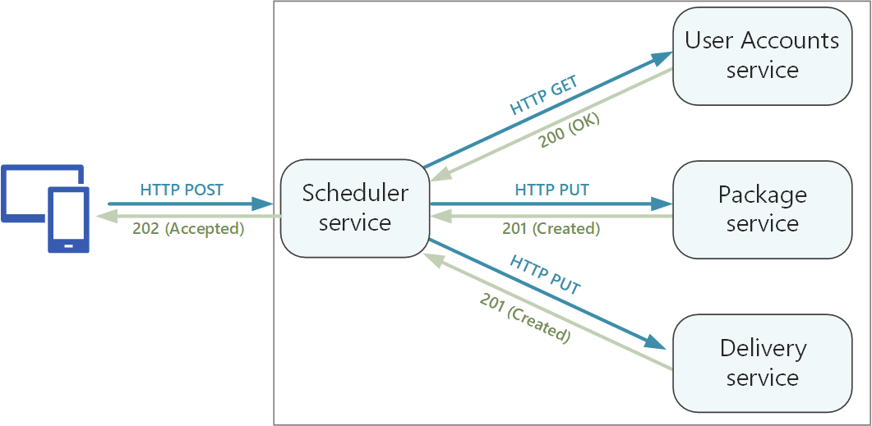
Passing order request
The order is passed to the grocery delivery service as an API request containing the required item, delivery address and payment method.

Slide 12
References
IoT Based Food Inventory Tracking System for Domestic and Commercial Kitchens by Ashwini S. Shelake, Pratiksha V. Sonawane, Supriya S. Ghumare, Pranjal S. Deshmukh, Pooja R. Pingale
IoT Based Smart Kitchen by Sravya Mandadi , Yashaswini C , Suraksha M, Mrs. Seema R. Karanth
Smart grocery management system using internet of things by Chetal. S. Patil, Kanaksing. N. Pawar
The digital weight scale of IoT system using load cell sensor in UD. PANGRUKTI TANI by Yohanes Dhimas Sigit Budoyo , Anna Dara Andriana
IoT In Home Grocery Management by Akshay Pendbhaje, Prof. Sangeetha Rajesh
Home Groceries Management System Using IOT by T. Manikandan, D. Tamil Selvan, R. Vaidhyanathan, B. Vigneshvaran and V. Nandalal
A cloud IoT-enabled grocery management system by Jasleen Kaur, Pankaj Deep Kaur
IoT Based Smart Inventory Management System for Kitchen Using Weight Sensors, LDR, LED, Arduino Mega and NodeMCU (ESP8266) Wi-Fi Module with Website and App by Sifat Rezwan, Wasit Ahmed, Mahrin Alam Mahia and Mohammad Rezaul Islam
Grocery Re-identification using Load Balance Feature on the Shelf for Monitoring Grocery Inventory Rena Kamoda and Mayumi Ueda and Takuya Funatomi and Masaaki Iiyama and Michihiko Minoh
Design of portable IoT based Grocery tracking system via Wi-Fi module for Home Automation Divyaansh Singh, Neel Desai, Rohit R. Nair

Slide 13
Thank you

